Slide 1


Labor Force Demographics and Corporate Innovation
Derrien, Kecskes, and Nguyen
RFS | Forthcoming

Slide 2

Is Innovation Related to a Young Labor Force?
WSU
Research Question
Innovation Requires:
A long horizon outlook
The willingness to take risks
Creativity and interactivity
These (this premise) are traits of a younger population.
The aging of the population could affect long-term growth through a decrease in the ability of older societies to innovate.
“In younger areas, the entire ecosystem of workers is composed of employees that are more eager and more able to innovate, a feature that is beneficial to firms located in younger areas.”

Slide 3
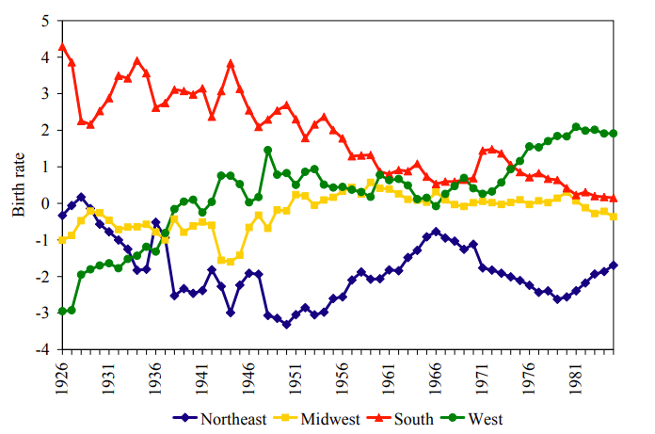
The Research Agenda
WSU
A Preface
Literature/ USDA ERS
Commuting Zone
Patent Citations
Patent Counts
Historical births at county level (1926-1985)
Age
(20-64)

Slide 4
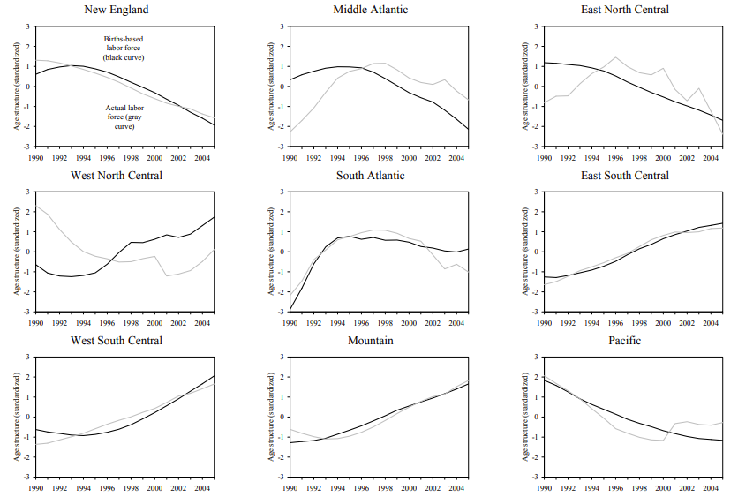
Birth-Based Age Structure
WSU
A Preface
“For every year (1990 – 2005) and for every commuting zone, we construct the ‘births-based labor force’.”
To the right shows that the births-based and actual labor forces generally follow the same direction
The validates some of the use of births-based age structure to instrument for the actual age structure
Pairwise correlation is “close to 0.5”
Data is detrended and standardized

Slide 5
Conditions for IV
WSU
Methods
A valid instrumental variable needs to satisfy both (1) relevance and (2) exogeneity:
It seems plausible that historical births affect innovation through the current age structure of the labor force (avoiding the exclusion restriction)
Other Channels
Suppose that a labor force that is more educated, by consequence, is more innovative
Suppose further that governments spend more on education when the population is younger
Here, the proximate cause of innovation might be education in a community with increasing births
Common Origins
Suppose a more prosperous local economy encourages younger workers to have children, the greater historical prosperity causes current labor force innovation
A series of controls

Slide 6
Firm-Level Analysis
WSU
Main
$${Innovation}_{i,j,a,c,s,t+1}=α{Age_Structure}_{c,t}+βX_{i,t}+γX_{c,t}+δ_{s,t}+δ_{j,t}+δ_{a}+ε (1)$$
Births-Based Age Structure and Actual Age Structure
The simplest, univariate regression shows births-based age structure significantly predicts actual age structure
Authors regress births-based age structure on their explanatory variables – R² of 84-85% (contemporaneous control variables capture a large proportion of the variation in age structure)
Age Structure and Innovation
One standard deviation decrease in uninstrumented age structure results in a 5-10% increase in innovation
Similarly, a typical increase in young share (0.92%) causes roughly 8% increase in patent counts and roughly 10% increase in patent citations

Slide 7
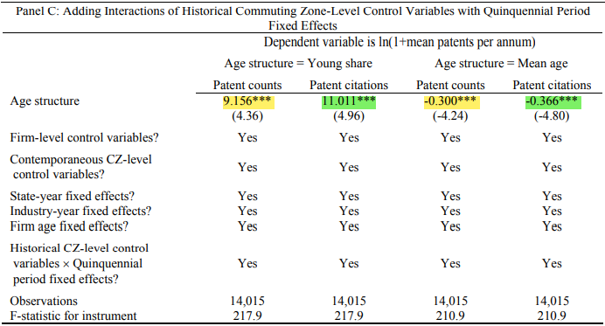
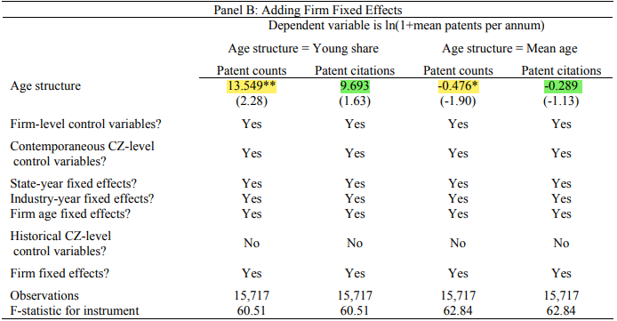
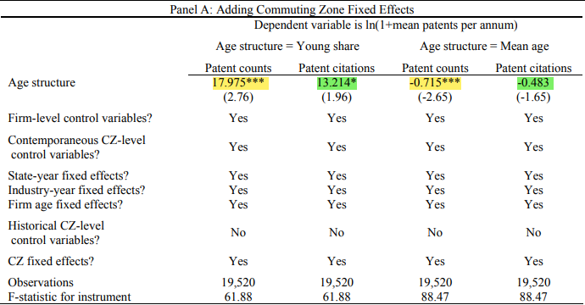
Firm-Level Analysis
WSU
Main
$${Innovation}_{i,j,a,c,s,t+1}=α{Age_Structure}_{c,t}+βX_{i,t}+γX_{c,t}+δ_{s,t}+δ_{j,t}+δ_{a}+ε (1)$$

Slide 8
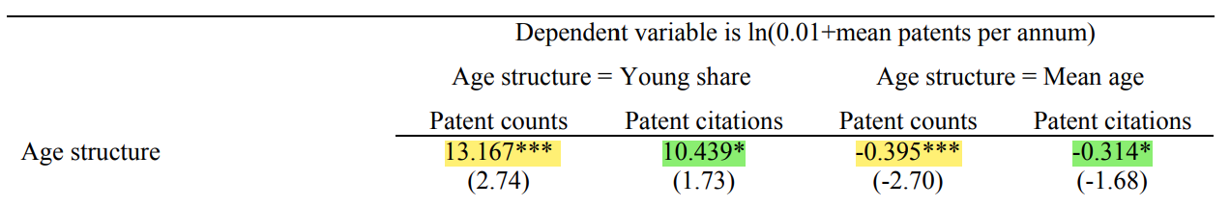
Inventor-Level Analysis
WSU
Secondary
$${Innovation}_{i,j,k,c,s,t+1}=α{Age_Structure}_{c,t}+βX_{k,t}+γX_{c,t}+δ_{s,t}+δ_{j,t}+δ_{i,t}+ε (1)$$
The Typical Sample Inventor
The typical inventor is ~ 49 years old
Has ~ 16 years of experience
Produces an average of 2.5 patents/year
A typical increase in young share (0.75%) causes a roughly 10% increase in patent counts
This same increase in young share accounts for roughly 8% increase in patent citations

Slide 9
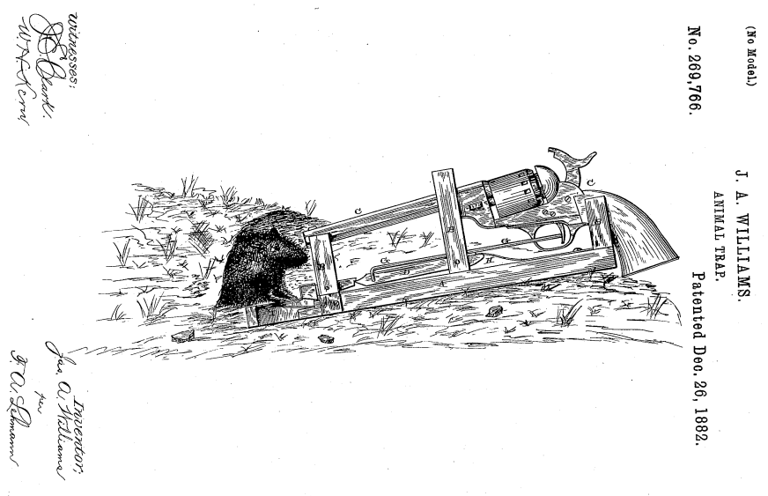
The Quality of Patents
WSU
Problems
Patent citations are adjusted for the changing distribution over technology class-year
Patent counts and citations are divided among individuals (investor-level analysis) – e.g., 1/n patents
This may just be an issue with labor economics
The Low Hanging Fruit – An Easy Dispute
Authors appear to treat (1) patents and (2) demographics the same

Slide 10
The Quality of Patents
WSU
Problems

Slide 11

Commuter Zone Bias
WSU
Problems
Derrien et al. → Autor & Dorn (2013) → Tolbert & Sizer (1996) → Economic Research Service (ERS)
San Jose (#218) San Francisco (#294)
“We measure age structure for firms using the commuting zone in which they are headquartered.”
2. This effect may be even more pronounced with permanent remote work (e.g., Twitter, Square, Meta, etc.)
1. Plausible that this headquarter may not represent their majority workforce or R&D (e.g., Boeing)

Slide 12


Foreign Migration?
WSU
Problems
Business Operations & Management
~22% of all business owners (US) are foreign-born (14% of the population)
Forbes Billionaires list includes 77 foreign-born entrepreneurs who built US companies (Google, Tesla, Yahoo, etc.)
Why The U.S. Is Losing Immigrant Entrepreneurs To Other Nations | Forbes
The Most Entrepreneurial Group in America Wasn't Born in America | Inc.com
True, Disruptive Inventions
From 1996 to 2011, the business startup rate of immigrants increased by more than 50% while the same number declined by 10% for native-born citizens (a 30-year low)
These 30 International Entrepreneurs Really Are Solving the World's Problems

Slide 13



Concluding Remarks
WSU
SUBTITLE
Value Implications:
The commercialization by firms of the innovations (from a younger workforce) increase market value
Conclusions:
Younger labor forces produce more innovation and more wealth – policy implications (immigration?)
How much do you need to torture the data to get your intended result?
An extension to international countries, looking at innovation in China, Bangladesh, etc.?

